Slide 1

Subject Code
18MEO113T - Design of Experiments
Handled by
S. Murali, Ph.D.,
Associate Professor,
Department of Mechanical Engineering, SRM IST, Kattankulathur.
Disclaimer
The content prepared in the presentation are from various sources, only used for education purpose. Thanks to all the sources.

Slide 2
Unit 4

Slide 3
Unit 4

Slide 4
Assumptions of Linearity in two-level designs
In general, significant proportion of experiments are performed with two-level factorials.
Two-level full factorial designs with k factors are denoted as 2^{k}
These models assume linear response
For example, linear regression model of 2² design is:
$$\hat{y}= β_{0}+β_{1}x_{1}+β_{2}x_{2}+β_{12}x_{1}x_{2}$$
Notes:
https://www.youtube.com/watch?v=O0NF4tKe5lM&t=3s

Slide 5
Assumptions of Linearity in two-level designs
Two-level factorial designs assumes linearity of response
In reality, the response may not be linear
The more the curvature or non-linearity, the more will be error in the prediction of interim values.
If the linearity is not large, the error in predicting interim values predicted by the model can be large.
y
-1
0
+1
Notes:
https://www.youtube.com/watch?v=O0NF4tKe5lM&t=3s

Slide 6
Assumptions of Linearity in two-level designs
How to minimize effect of non-linearlity
One possible recommendation is to select levels of the factors as close as possible.
This will help reducing the error. However, it will affect the magnitude of the effect/ response.
Magnitude of effect will be reduced.
y
-1
0
+1
Notes:
https://www.youtube.com/watch?v=O0NF4tKe5lM&t=3s

Slide 7
Addition of Center Point
Therefore experimenters often add a center point in the design.
The purpose of adding a center point is to validate the assumption of linearity.
If the response at the center point is significantly different than the predicted value on the straight line, then a non linear model will be required to reduce the error. This can be done with a Response Surface Design.
2² design with center point
+1
B
-1
-1
0
+1
A
Notes:
https://www.youtube.com/watch?v=O0NF4tKe5lM&t=3s

Slide 8
Background of response surface design
Response Surface Methodology, or RSM, is a collection of mathematical and statistical techniques useful for the modeling and analysis of problems in which a response of interest is influenced by several variables and the objective is to optimize this response.
Xi
Process/System
Response (Ex: Process yield, defects, etc.)
Zi
Setting the X in the particular range or zone by that we can able to get the optimal response value.
Notes:
https://www.youtube.com/watch?v=O0NF4tKe5lM&t=3s

Slide 9
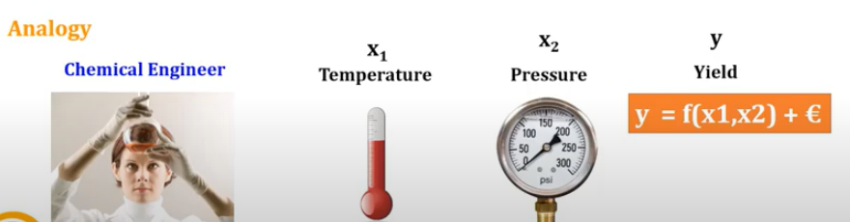
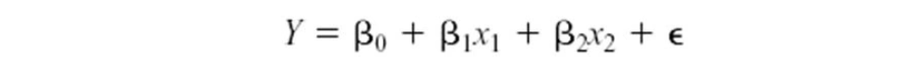
Background of response surface design
RSM, is a collection of mathematical and statistical techniques useful for the developing, improving, and optimizing processes.
Notes:
https://www.youtube.com/watch?v=O0NF4tKe5lM&t=3s

Slide 10
Background of response surface design
The difference between a response surface equation and the equation for a factorial design is the addition of the squared (or quadratic) terms that lets you model curvature in the response, making them useful for:
Understanding or mapping a region of a response surface. Response surface equations model how changes in variables affect a response of interest.
Finding the levels of variables that optimize a response.
Selecting the operating conditions to meet specifications.
For example, you would like to determine the best conditions for injection-molding a plastic part. You first used a screening or factorial experiment to determine the significant factors (temperature, pressure, cooling rate). You can use a response surface designed experiment to determine the optimal settings for each factor.
Notes:
https://www.youtube.com/watch?v=O0NF4tKe5lM&t=3s

Slide 11
Background of response surface design
The difference between a response surface equation and the equation for a factorial design
A two-level factorial (or fractional factorial) design looks for linear trends, possibly with interactions
Does the variable significantly impact the response? In what direction?
It helps to define the next experiment.
Response Surface Methodology (RSM) looks for quadratic or higher order trends
Assumes all variable are significant
A quadratic response always has a stationary point (minimum or maximum or saddle point)
Can be used to optimize a process
Notes:
https://www.youtube.com/watch?v=O0NF4tKe5lM&t=3s

Slide 12
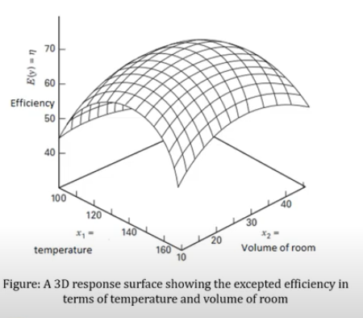
Background of response surface design
Notes:
https://www.youtube.com/watch?v=O0NF4tKe5lM&t=3s

Slide 13
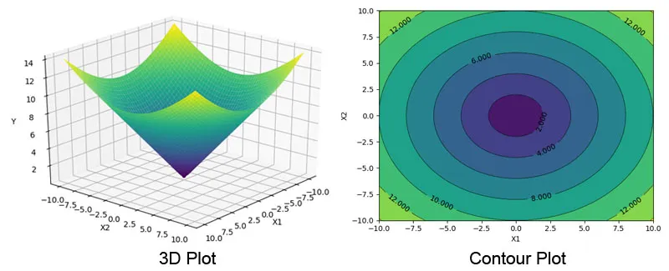
Background of response surface design
Notes:
https://www.youtube.com/watch?v=O0NF4tKe5lM&t=3s

Slide 14
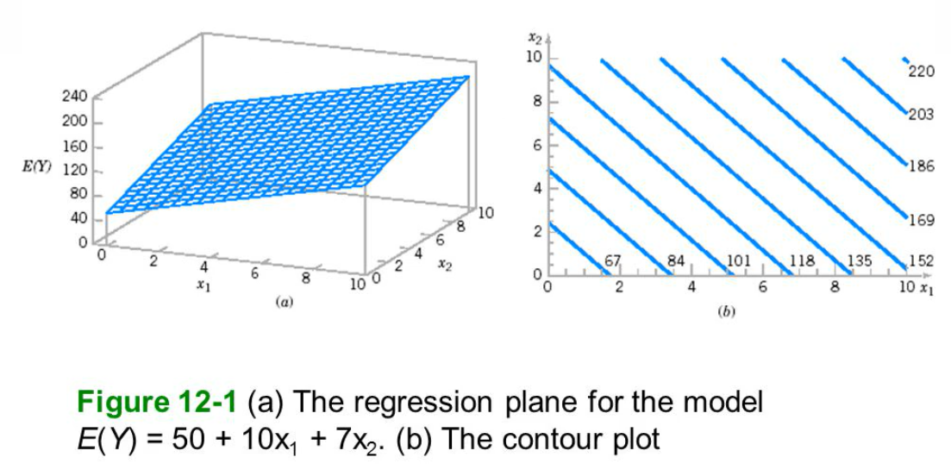
Background of response surface design
Notes:
https://www.youtube.com/watch?v=O0NF4tKe5lM&t=3s

Slide 15
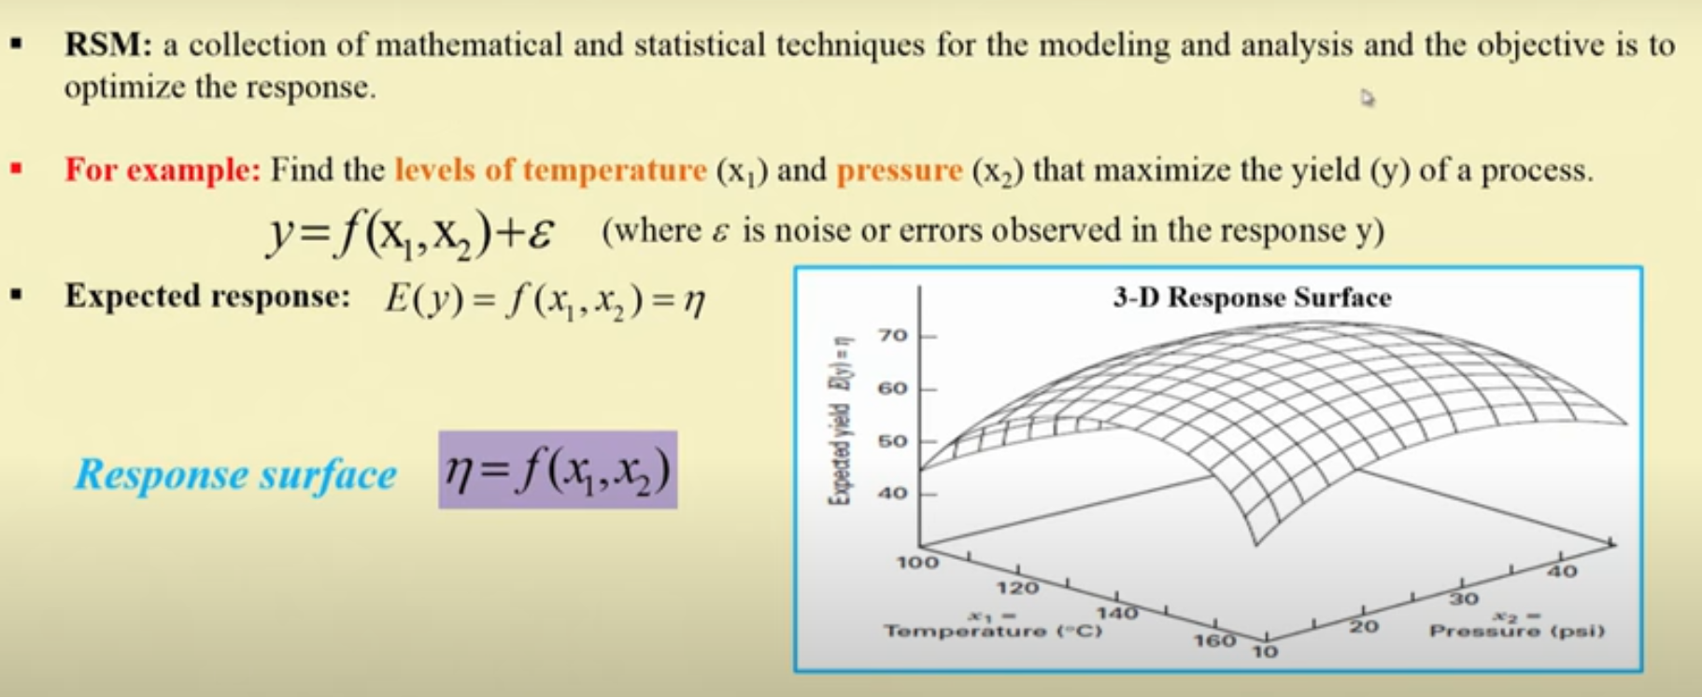
Background of response surface design
Notes:
https://www.youtube.com/watch?v=O0NF4tKe5lM&t=3s

Slide 16
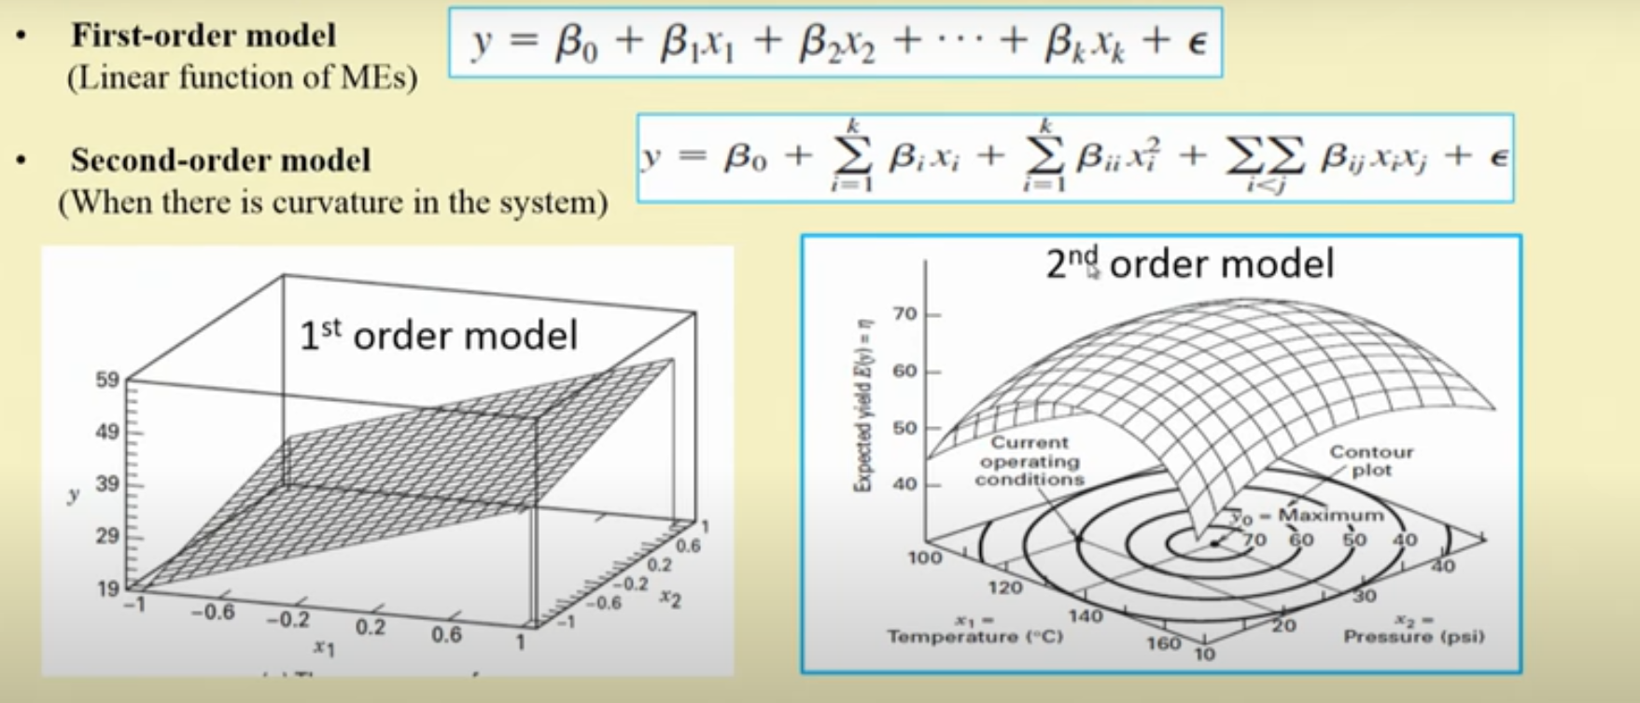
Background of response surface design
Notes:
https://www.youtube.com/watch?v=O0NF4tKe5lM&t=3s

Slide 17
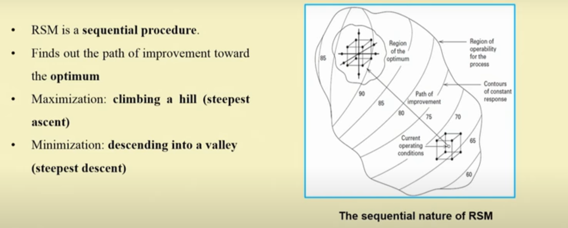
Background of response surface design
Notes:
https://www.youtube.com/watch?v=O0NF4tKe5lM&t=3s

Slide 18
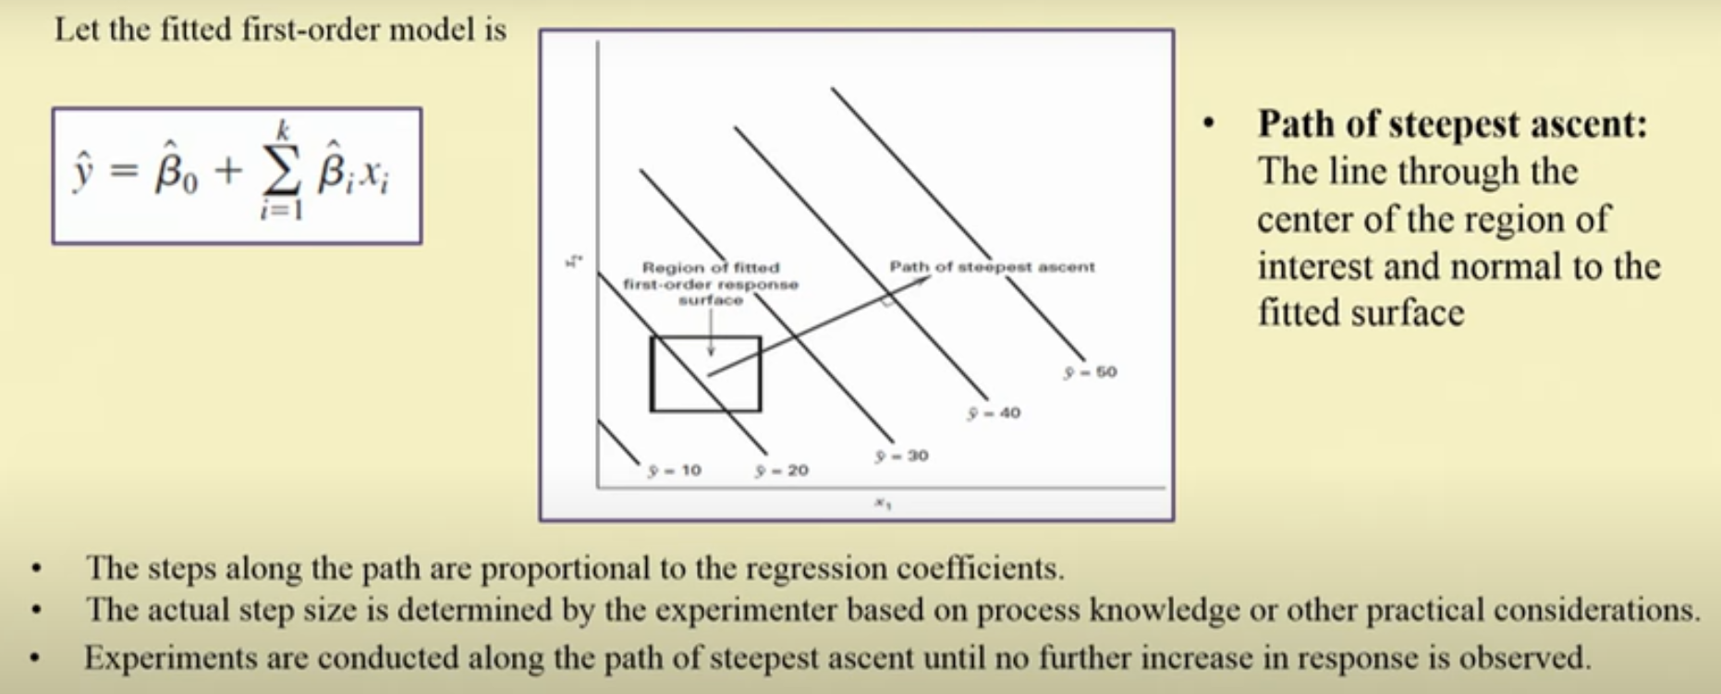
Background of response surface design
The Method of Steepest Ascent
Notes:
https://www.youtube.com/watch?v=O0NF4tKe5lM&t=3s

Slide 19
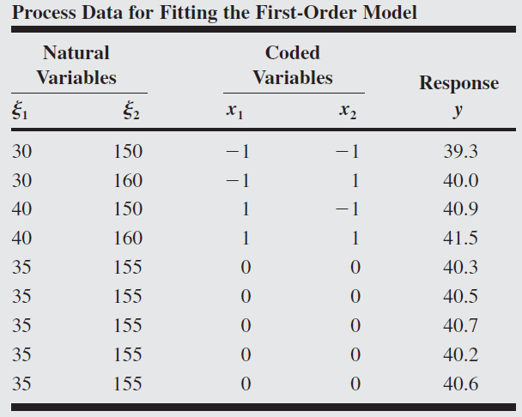
Example 1 (First-order RSM)
A chemical engineer is interested in determining the operating conditions that maximize the yield of a process. Two controllable variables influence process yield: reaction time and reaction temperature. The engineer is currently operating the process with a reaction time of 35 minutes and a temperature of 155°F, which result in yields of around 40 percent. Because it is unlikely that this region contains the optimum, she fits a first-order model and applies the method of steepest ascent.

Slide 20
Example 1 (RSM First-order Model)
Response variable = Process yield = Y = 40%
Current operating condition:
Natural variable ${(ε}_{1}$) = Coded variable (X1) = Reaction time of 35 minutes
Natural variable ${(ε}_{2}$) = Coded variable (X2) = Temperature of 155°F
2^{K} factorial design with center point
X1: High = 40 min (+1); Low = 30 min (-1)
X2: High = 160 F (+1); Low = 150 F (-1)
X2
160
Temp
(35, 155)
150
30
40
Time
X1

Slide 21
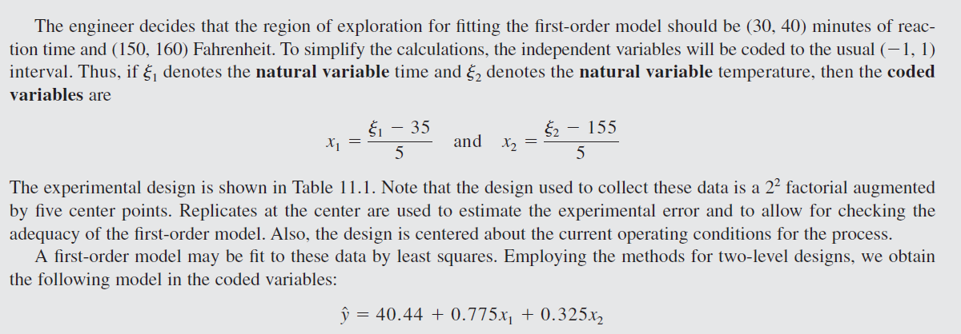
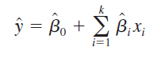
Example 1 (First-order RSM)
Y=$β_{0}$+$β_{1}X_{1}$+$β_{2}X_{2}$
40.44 = Average of all Y observation ($β_{0}$)…
$β_{1 }= \frac{1}{2}(Effect of X1)$ =$\frac{1}{2}(\left(\frac{40.9+41.5}{2}\right)−(\frac{39.3+40.0}{2}))$ = 0.775
$β_{2 }= \frac{1}{2}(Effect of X2)$ = $\frac{1}{2}(\left(\frac{40+41.5}{2}\right)−(\frac{39.3+40.9}{2}))$ = 0.325

Slide 22
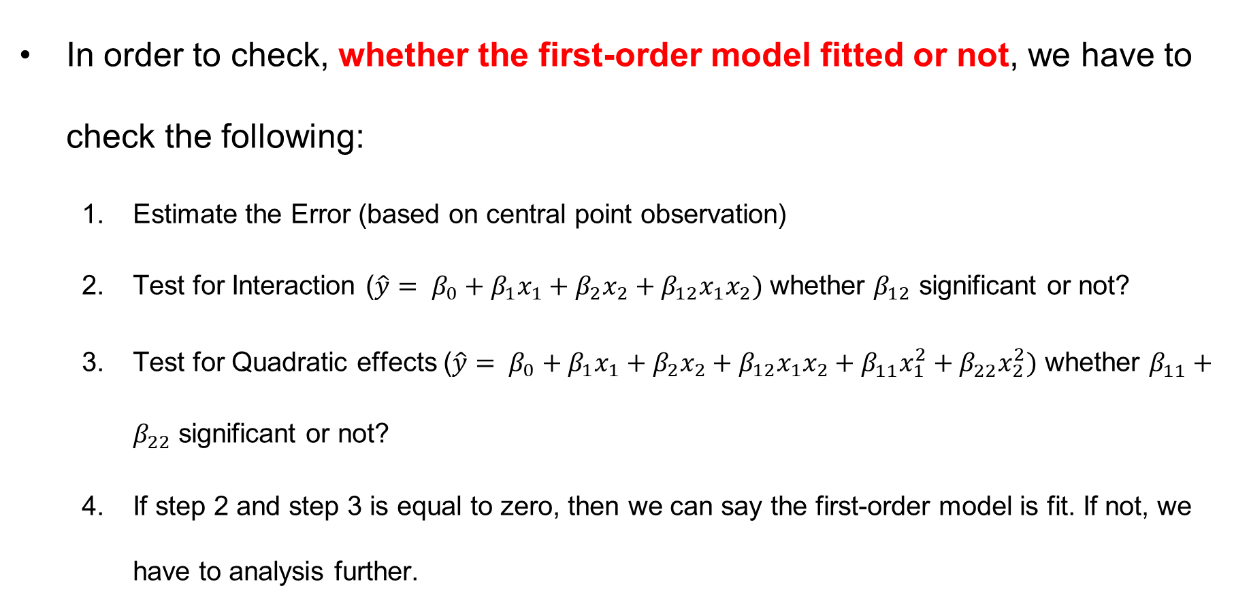
Example 1 (First-order RSM)
In order to check, whether the first-order model fitted or not, we have to check the following:
Estimate the Error (based on central point observation)
Test for Interaction ($\hat{y}= β_{0}+β_{1}x_{1}+β_{2}x_{2}+β_{12}x_{1}x_{2})$ whether $β_{12}$ significant or not?
Test for Quadratic effects ($\hat{y}= β_{0}+β_{1}x_{1}+β_{2}x_{2}+β_{12}x_{1}x_{2}+β_{11}^{}x_{1}^{2}+β_{22}^{}x_{2}^{2})$ whether $β_{11}^{}+β_{22}^{}$ significant or not?
If step 2 and step 3 is equal to zero, then we can say the first-order model is fit. If not, we have to analysis further.

Slide 23
Example 1 (First-order RSM)
Step 1. Estimate the Error (based on central point observation)
Error = [Sum of square of all the values/responses – (squares of sum of all the values)/n] / n-1
The mean square Error (MS_{E}) = 0.0430

Slide 24
Example 1 (First-order RSM)
Step 2. Test for Interaction Estimate the Error
The first-order model assumes that the variables x1 and x2 have an additive effect on the response. The interaction between the variables would be represented by the coefficient of $β_{12}$ of a cross-product term x1x2 added to the model.
The least squares estimate of this coefficient is just one-half the interaction effect calculated as in an ordinary 2² factorial design,

Slide 25
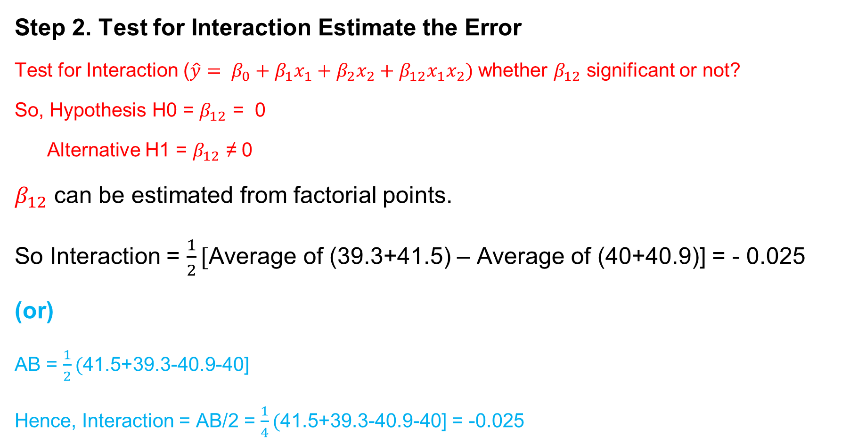
Example 1 (First-order RSM)
Step 2. Test for Interaction Estimate the Error
Test for Interaction ($\hat{y}= β_{0}+β_{1}x_{1}+β_{2}x_{2}+β_{12}x_{1}x_{2})$ whether $β_{12}$ significant or not?
So, Hypothesis H0 = $β_{12}$ = 0
Alternative H1 = $β_{12}$ ≠ 0
$β_{12}$ can be estimated from factorial points.
So Interaction = $\frac{1}{2}[$Average of (39.3+41.5) – Average of (40+40.9)] = - 0.025
(or)
AB = $\frac{1}{2}($41.5+39.3-40.9-40]
Hence, Interaction = AB/2 = $\frac{1}{4}($41.5+39.3-40.9-40] = -0.025
40
41.5
39.3
40.9

Slide 26
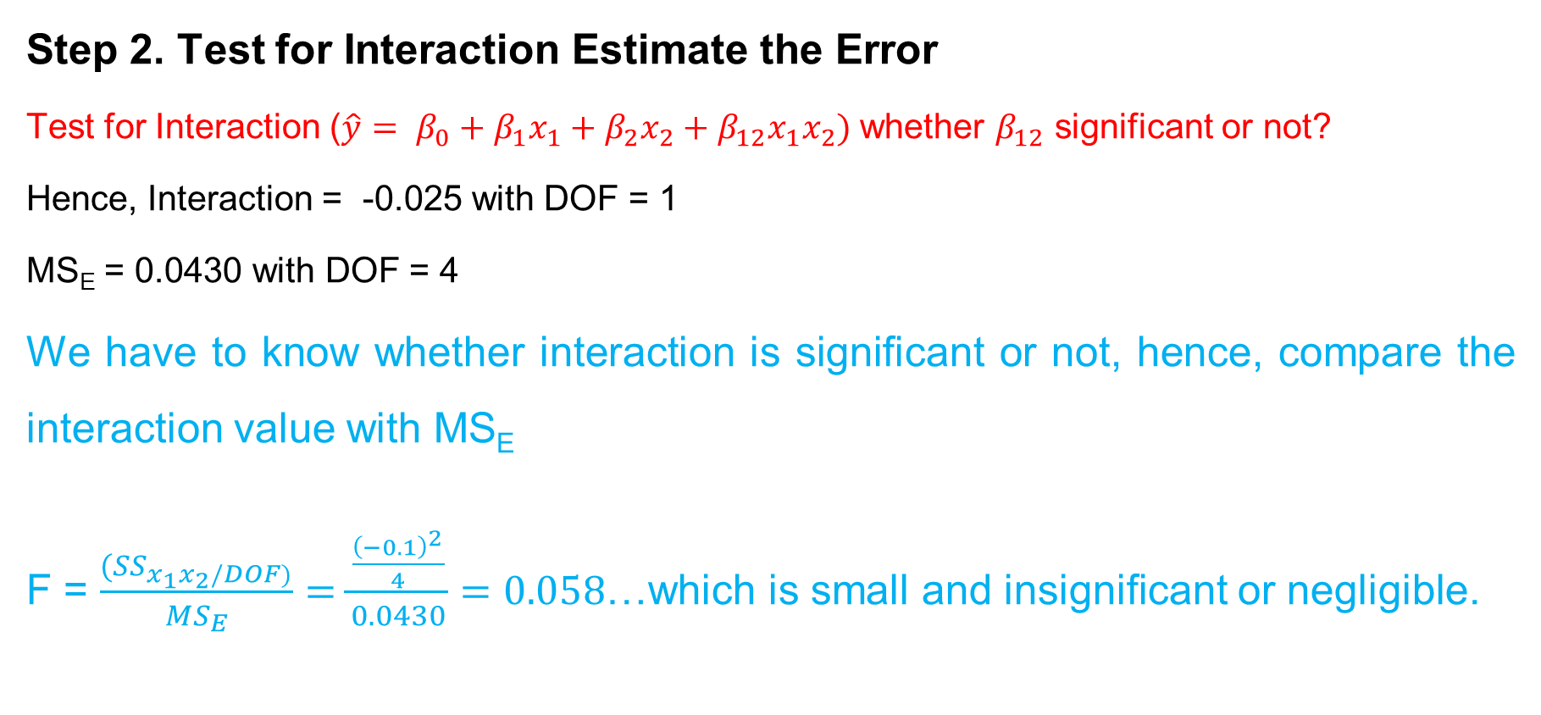
Example 1 (First-order RSM)
Step 2. Test for Interaction Estimate the Error
Test for Interaction ($\hat{y}= β_{0}+β_{1}x_{1}+β_{2}x_{2}+β_{12}x_{1}x_{2})$ whether $β_{12}$ significant or not?
Hence, Interaction = -0.025 with DOF = 1
MS_{E} = 0.0430 with DOF = 4
We have to know whether interaction is significant or not, hence, compare the interaction value with MS_{E}
F = $\frac{{(SS}_{x_{1}x_{2}/DOF)}}{{MS}_{E}}=\frac{\frac{{\left(−0.1\right)}^{2}}{4}}{0.0430}=0.058$…which is small and insignificant or negligible.

Slide 27
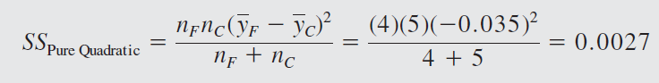
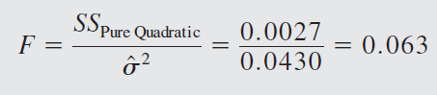
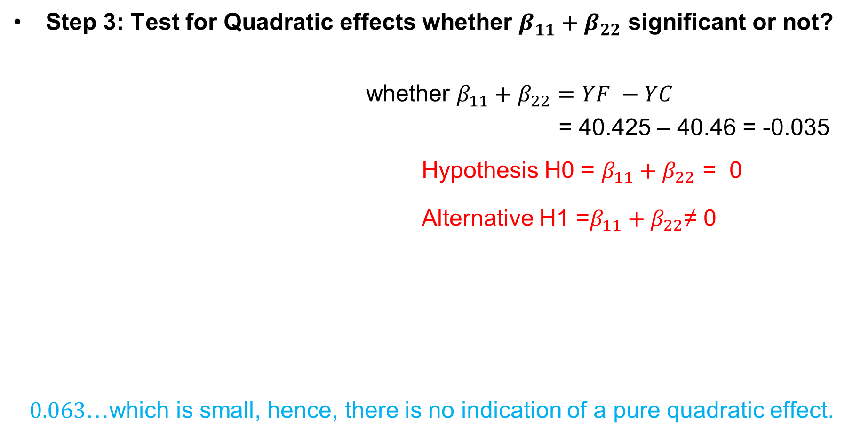
Example 1 (First-order RSM)
Step 3: Test for Quadratic effects whether $β_{11}^{}+β_{22}^{}$ significant or not?
whether $β_{11}^{}+β_{22}^{}=YF −YC$
= 40.425 – 40.46 = -0.035
Hypothesis H0 = ${β_{11}+β}_{22}$ = 0
Alternative H1 =${β_{11}+β}_{22}$≠ 0
$0.063$…which is small, hence, there is no indication of a pure quadratic effect.
Factorial portion
Factorial portion
Center point
Factorial portion
Factorial portion
So, quadratic effect not there…interaction effect not there…hence, the first-order model is fit one.

Slide 28
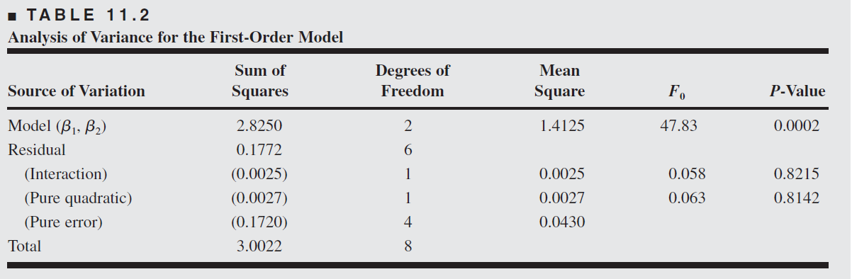
Example 1 (First-order RSM)
0.02953
SS Total =(39.3²+ 40²+ 40.9²+ 41.5²+ 40.3²+ 40.5²+ 40.7²+ 40.2²+ 40.6²) – [(39.3+40+40.9+41.5+40.3+40.5+40.7+40.2+40.6)²/9] =3.0022
SS Model = SS total – SS residual = 3.0022 – 0.1772 = 2.8250
F-Model = 2.8250/0.02953 = 47.83

Slide 29
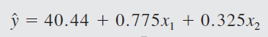
Example 1 (First-order RSM)
Hence, we can say $\hat{y}= β_{0}+β_{1}x_{1}+β_{2}x_{2}$ is fit one…..
However, we need to ensure whether the parameters $β_{1}$ and$β_{2}$ is significant….by doing Test of Parameter Estimates..
For that, we need to identify the variance of $β_{i}$….i.e., V($β_{i}$)
V($β_{i}$) = $\frac{{MS}_{E}}{4}$
SE($β_{i}$) = $\sqrt{\frac{{MS}_{E}}{4}}$=$\sqrt{\frac{0.0430}{4}}=0.1$
Both regression coefficients and are large relative to their standard errors. At this point, we have no reason to question the adequacy of the first-order model.

Slide 30
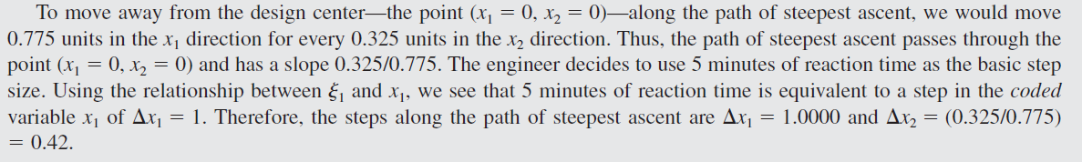
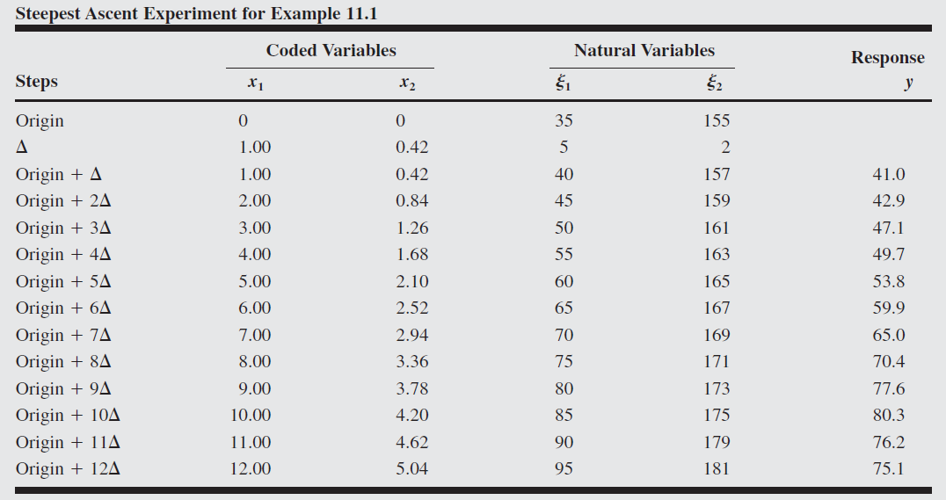
Example 1 (First-order RSM)
X2 (Temp)
Center point (0,0)
X1 (Time)

Slide 31
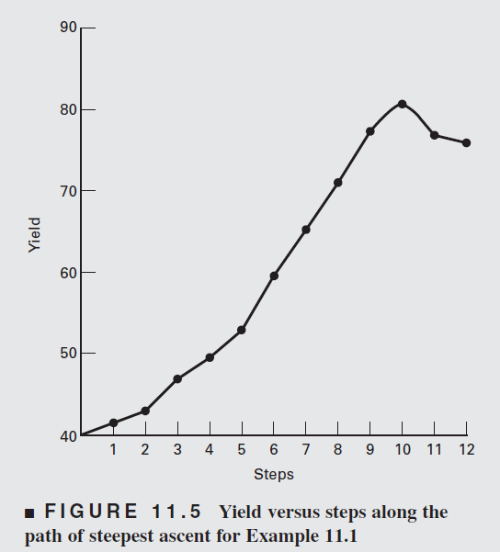
Example 1 (First-order RSM)
180
85, 175
170
160
80
90
35, 155
150
30
40

Slide 32
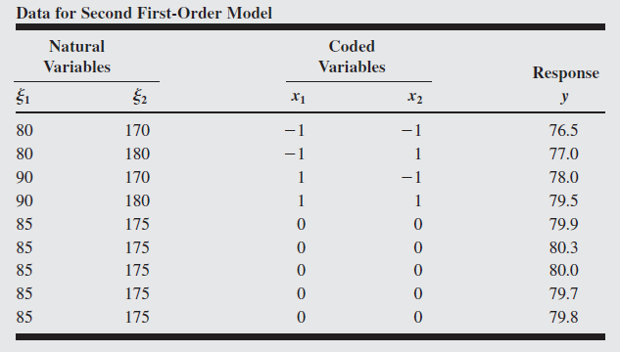
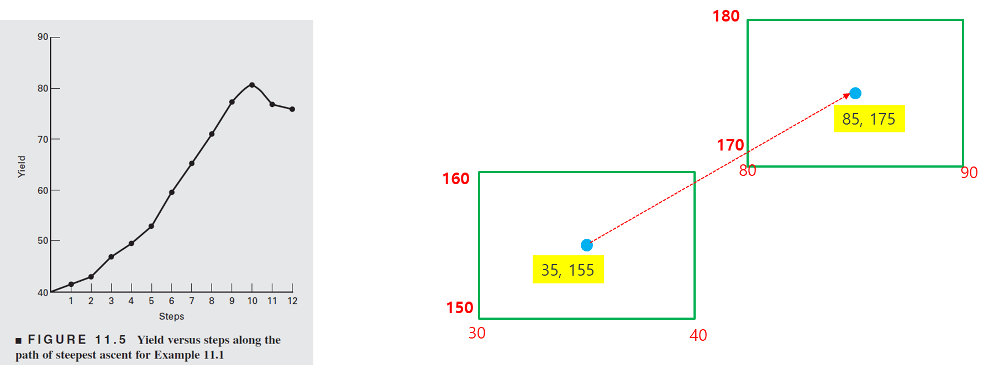
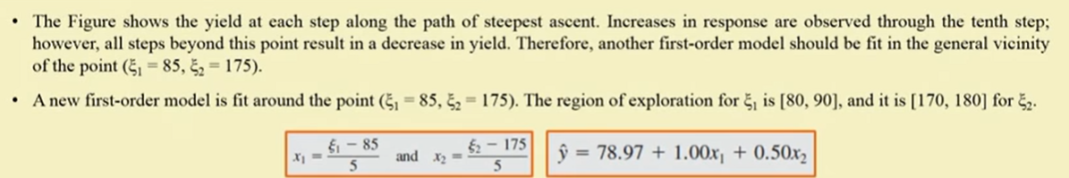
Example 1 (First-order RSM)
78.97 = Average of all Y observation ($β_{0}$)…
$β_{1 }= \frac{1}{2}(Effect of X1)$ =$\frac{1}{2}(\left(\frac{78+79.5}{2}\right)−(\frac{76.5+77}{2}))$ = 1
$β_{2 }= \frac{1}{2}(Effect of X2)$ = $\frac{1}{2}(\left(\frac{77+79.5}{2}\right)−(\frac{376.5+78}{2}))$ = 0.5

Slide 33
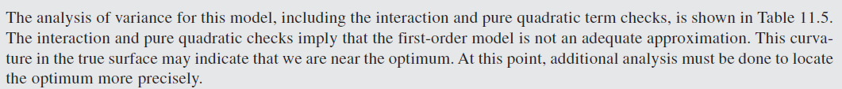
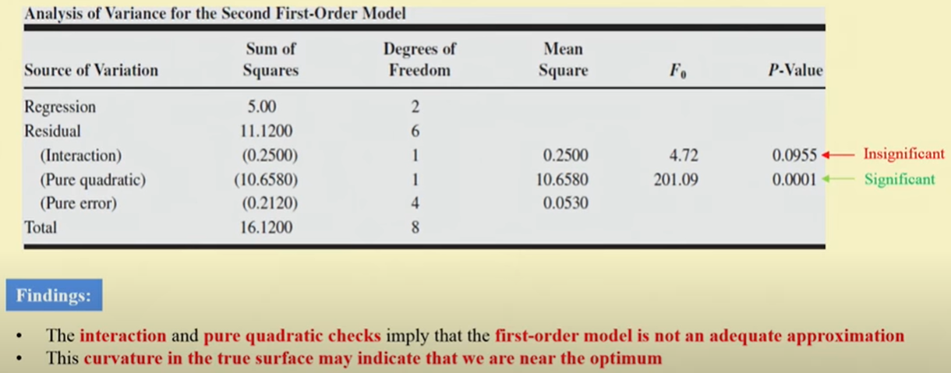
Example 1 (First-order RSM)

Slide 34
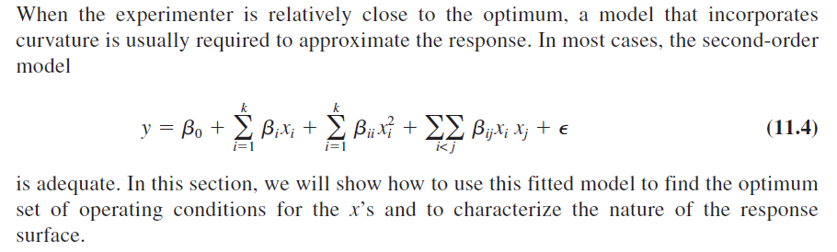
Analysis of a Second-Order Response Surface

Slide 35
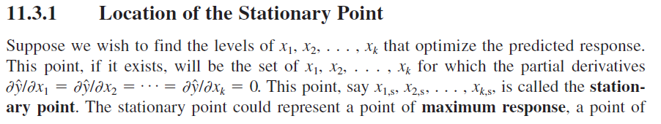
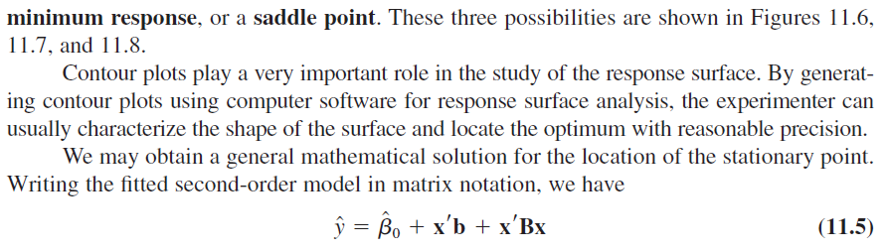
Analysis of a Second-Order Response Surface

Slide 36
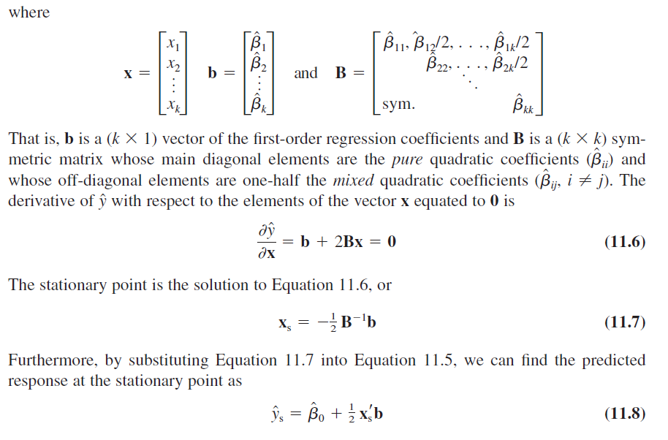
Analysis of a Second-Order Response Surface

Slide 37
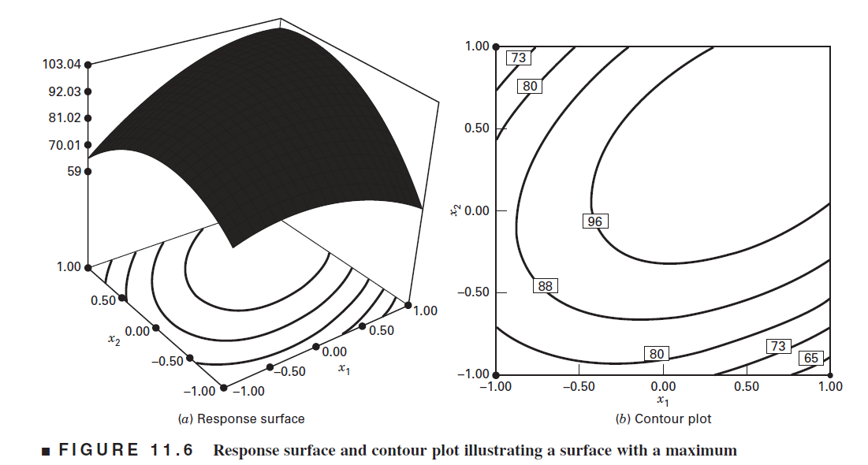
Analysis of a Second-Order Response Surface

Slide 38
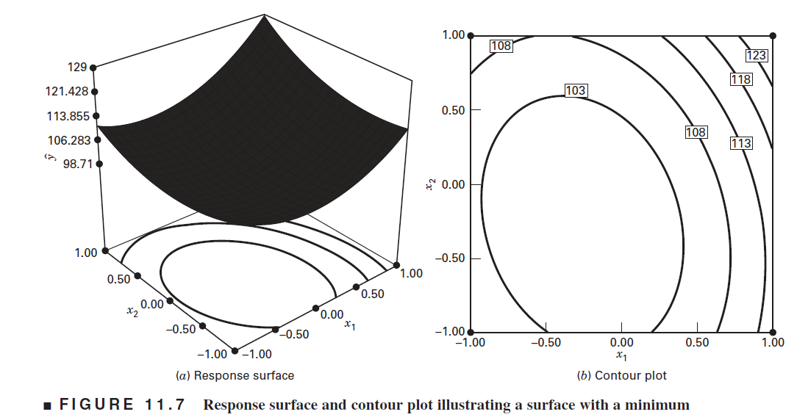
Analysis of a Second-Order Response Surface

Slide 39
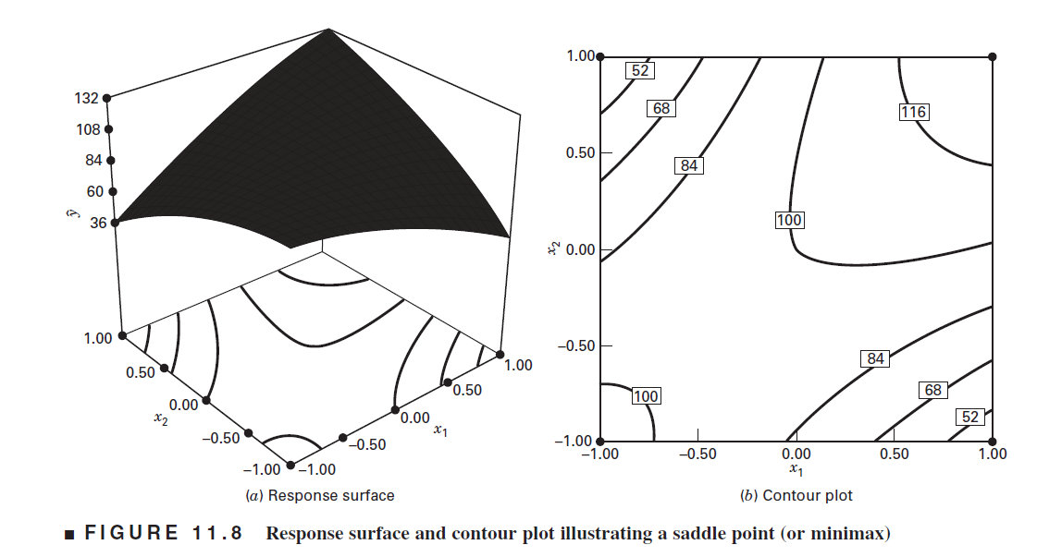
Analysis of a Second-Order Response Surface

Slide 40
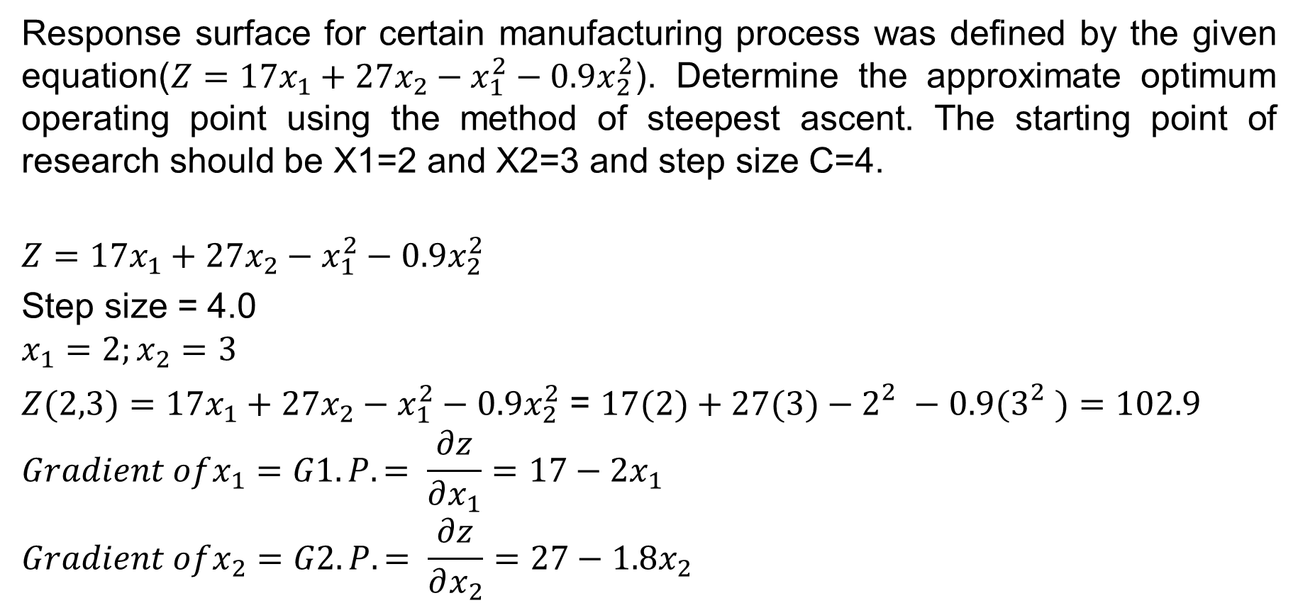
Example for Second-Order Response Surface.
Response surface for certain manufacturing process was defined by the given equation($Z=17x_{1}+27x_{2}−x_{1}^{2}−0.9x_{2}^{2}$). Determine the approximate optimum operating point using the method of steepest ascent. The starting point of research should be X1=2 and X2=3 and step size C=4.
$$Z=17x_{1}+27x_{2}−x_{1}^{2}−0.9x_{2}^{2}$$
Step size = 4.0
$$x_{1}=2;x_{2}=3$$
$Z(2,3)=17x_{1}+27x_{2}−x_{1}^{2}−0.9x_{2}^{2}$ = $17(2)+27(3)−2_{}^{2}−0.9{(3}_{}^{2})=102.9$
$$Gradient ofx_{1}=G1.P. = \frac{∂z}{∂x_{1}}=17−2x_{1}$$
$$Gradient ofx_{2}=G2.P. = \frac{∂z}{∂x_{2}}=27−1.8x_{2}$$

Slide 41
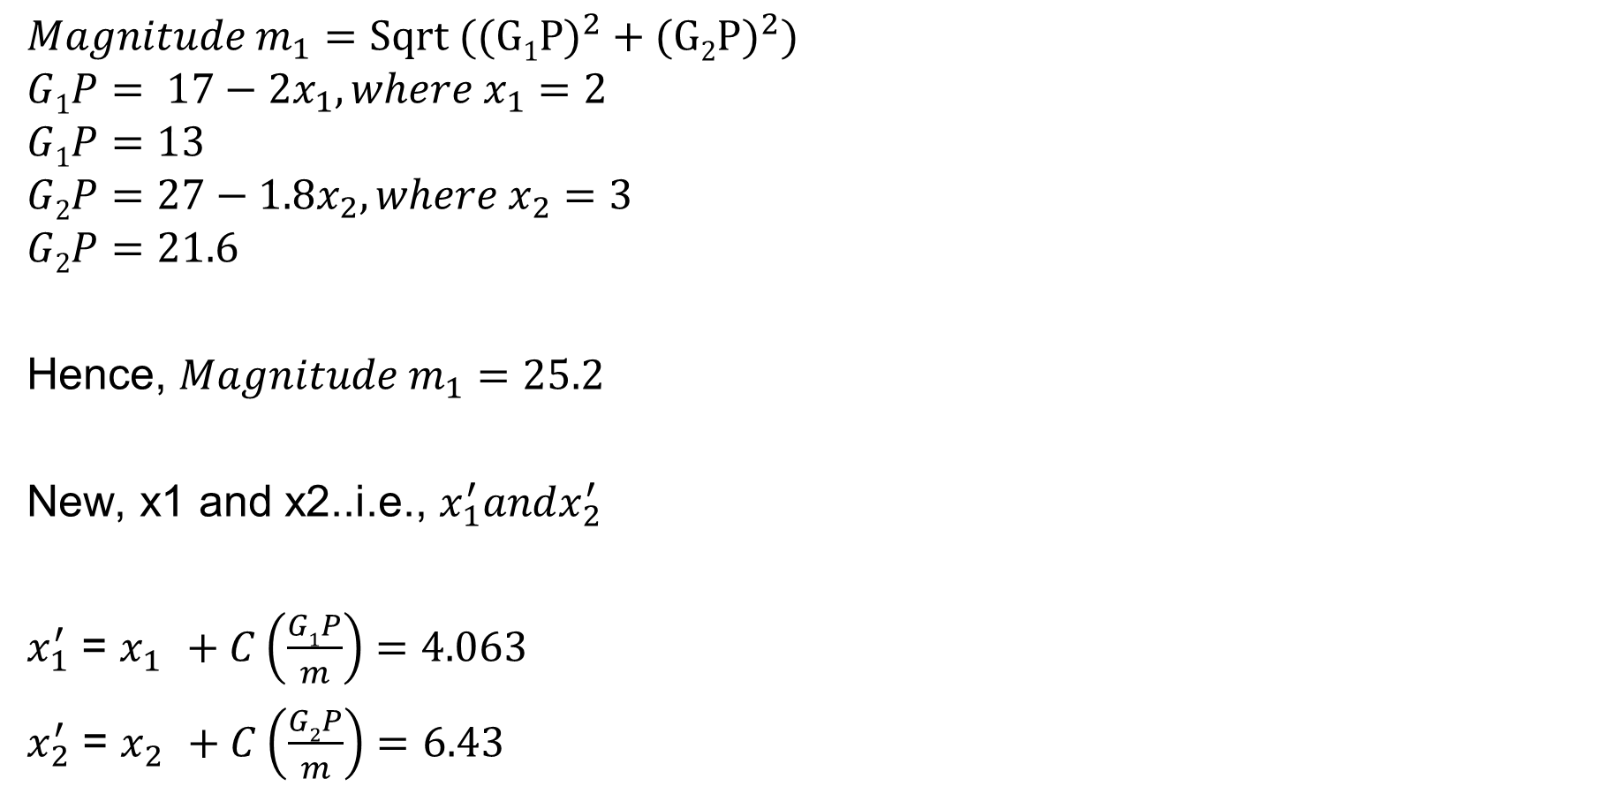
Example.
$$Magnitude m_{1}=Sqrt ((G1{P)}^{2}+(G2{P)}^{2})$$
$$G1P= 17−2x_{1}, where x_{1}=2$$
$$G1P=13$$
$$G2P=27−1.8x_{2}, where x_{2}=3$$
$$G2P=21.6$$
Hence, $Magnitude m_{1}=25.2$
New, x1 and x2..i.e., $x_{1}^{′}andx_{2}^{′}$
$x_{1}^{′}$ = $x_{1}^{}+C\left(\frac{G1P}{m}\right)=4.063$
$x_{2}^{′}$ = $x_{2}^{}+C\left(\frac{G2P}{m}\right)=6.43$

Slide 42
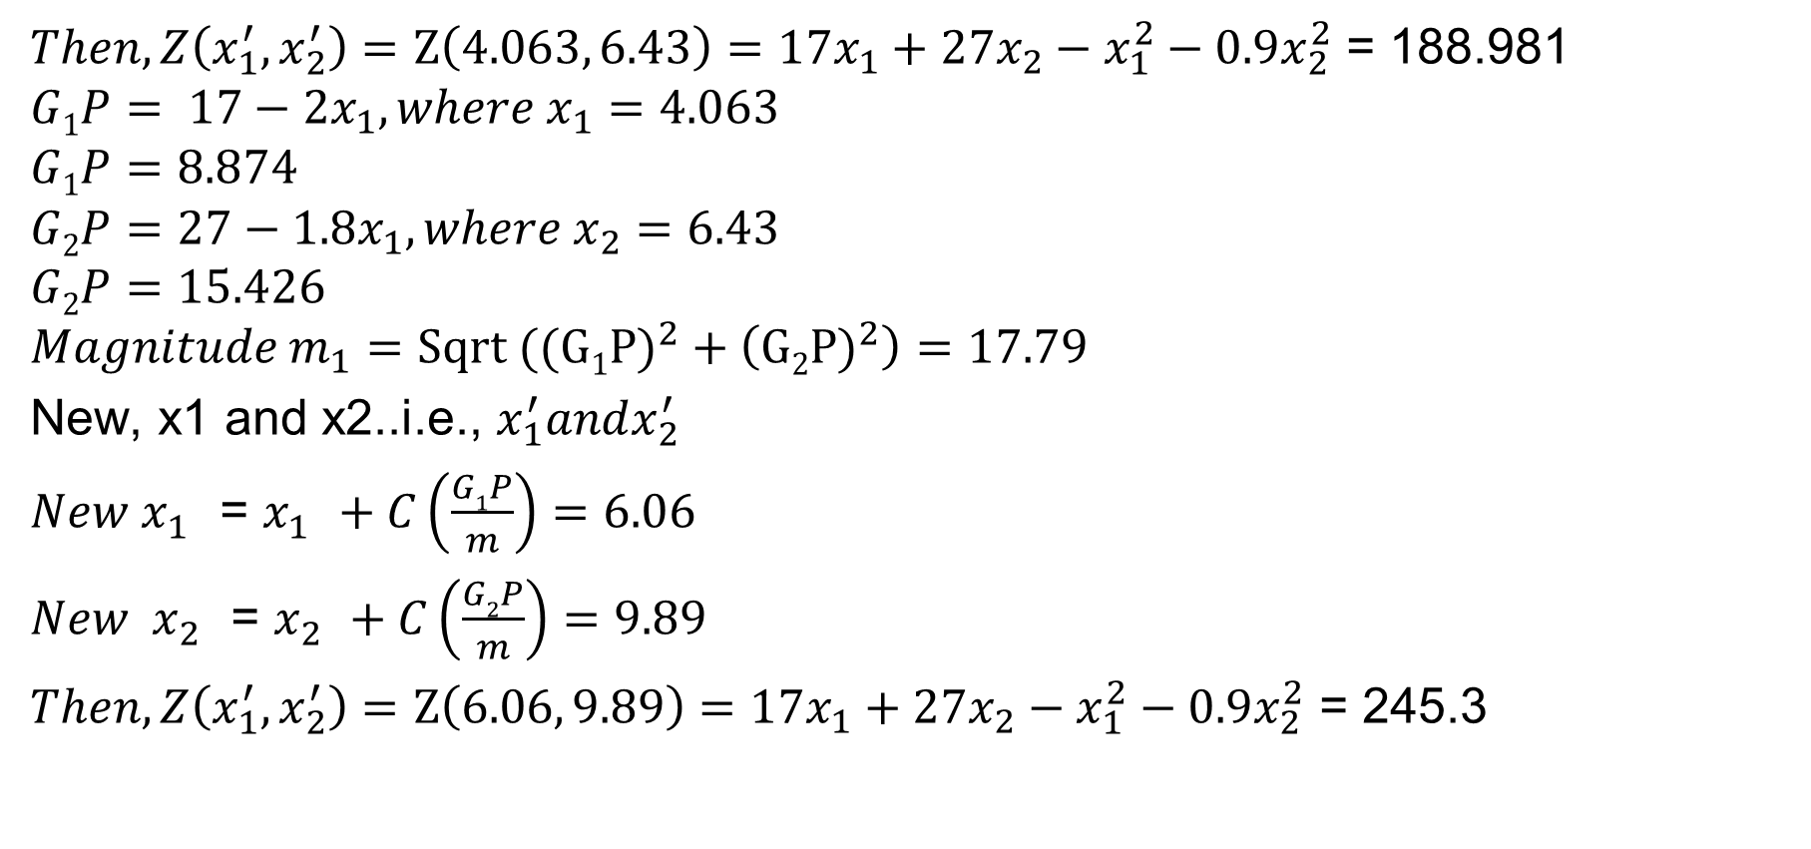
Example.
$Then, Z\left(x_{1}^{′},x_{2}^{′}\right)=Z\left(4.063, 6.43\right)=17x_{1}+27x_{2}−x_{1}^{2}−0.9x_{2}^{2}$ = 188.981
$$G1P= 17−2x_{1}, where x_{1}=4.063$$
$$G1P=8.874$$
$$G2P=27−1.8x_{1}, where x_{2}=6.43$$
$$G2P=15.426$$
$$Magnitude m_{1}=Sqrt ((G1{P)}^{2}+\left(G2{P)}^{2}\right)=17.79$$
New, x1 and x2..i.e., $x_{1}^{′}andx_{2}^{′}$
$New x_{1}^{}$ = $x_{1}^{}+C\left(\frac{G1P}{m}\right)=6.06$
${New x}_{2}^{}$ = $x_{2}^{}+C\left(\frac{G2P}{m}\right)=9.89$
$Then, Z\left(x_{1}^{′},x_{2}^{′}\right)=Z\left(6.06, 9.89\right)=17x_{1}+27x_{2}−x_{1}^{2}−0.9x_{2}^{2}$ = 245.3

Slide 43
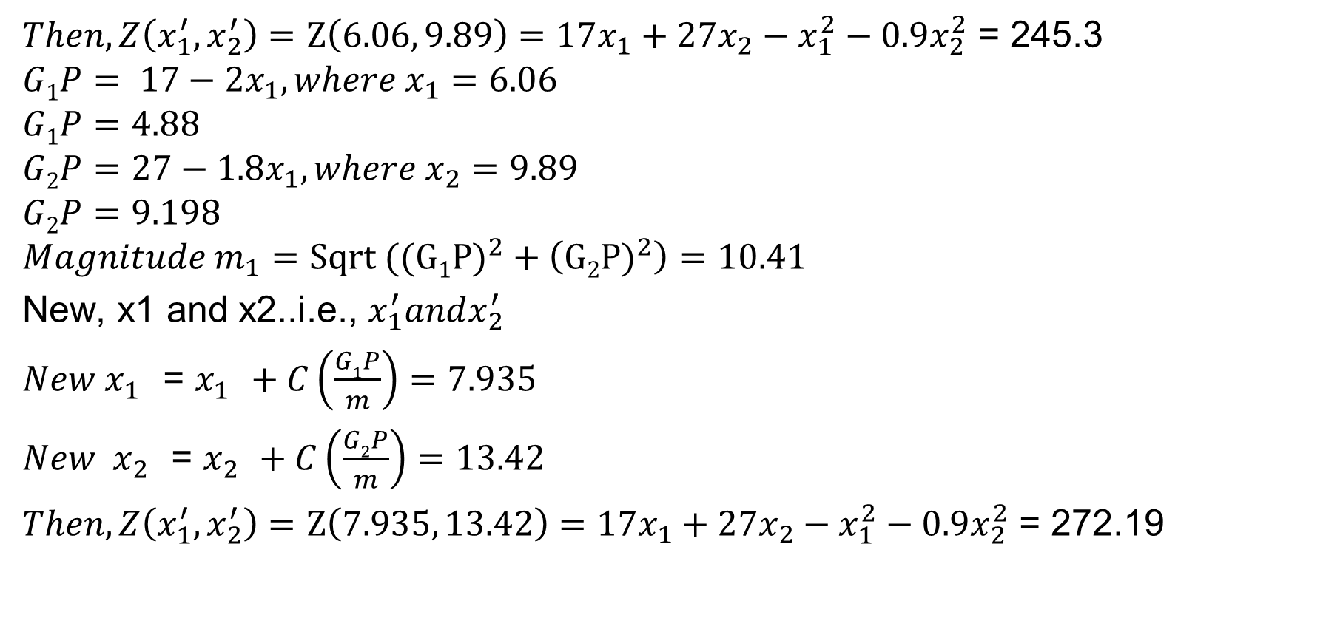
Example.
$Then, Z\left(x_{1}^{′},x_{2}^{′}\right)=Z\left(6.06, 9.89\right)=17x_{1}+27x_{2}−x_{1}^{2}−0.9x_{2}^{2}$ = 245.3
$$G1P= 17−2x_{1}, where x_{1}=6.06$$
$$G1P=4.88$$
$$G2P=27−1.8x_{1}, where x_{2}=9.89$$
$$G2P=9.198$$
$$Magnitude m_{1}=Sqrt ((G1{P)}^{2}+\left(G2{P)}^{2}\right)=10.41$$
New, x1 and x2..i.e., $x_{1}^{′}andx_{2}^{′}$
$New x_{1}^{}$ = $x_{1}^{}+C\left(\frac{G1P}{m}\right)=7.935$
${New x}_{2}^{}$ = $x_{2}^{}+C\left(\frac{G2P}{m}\right)=13.42$
$Then, Z\left(x_{1}^{′},x_{2}^{′}\right)=Z\left(7.935, 13.42\right)=17x_{1}+27x_{2}−x_{1}^{2}−0.9x_{2}^{2}$ = 272.19

Slide 44
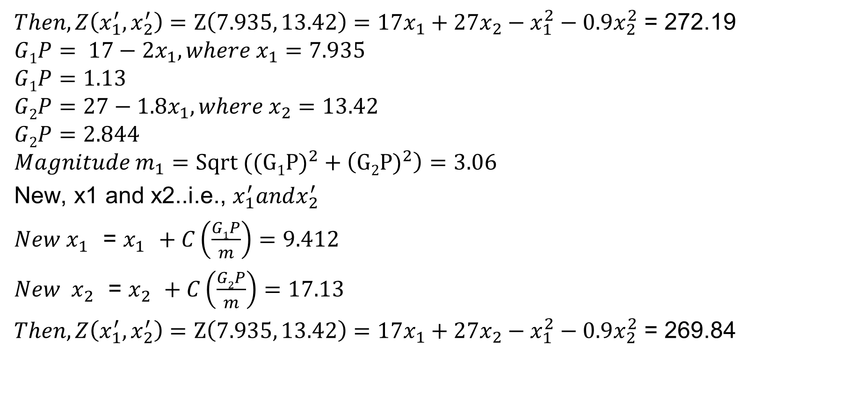
Example.
$Then, Z\left(x_{1}^{′},x_{2}^{′}\right)=Z\left(7.935, 13.42\right)=17x_{1}+27x_{2}−x_{1}^{2}−0.9x_{2}^{2}$ = 272.19
$$G1P= 17−2x_{1}, where x_{1}=7.935$$
$$G1P=1.13$$
$$G2P=27−1.8x_{1}, where x_{2}=13.42$$
$$G2P=2.844$$
$$Magnitude m_{1}=Sqrt ((G1{P)}^{2}+\left(G2{P)}^{2}\right)=3.06$$
New, x1 and x2..i.e., $x_{1}^{′}andx_{2}^{′}$
$New x_{1}^{}$ = $x_{1}^{}+C\left(\frac{G1P}{m}\right)=9.412$
${New x}_{2}^{}$ = $x_{2}^{}+C\left(\frac{G2P}{m}\right)=17.13$
$Then, Z\left(x_{1}^{′},x_{2}^{′}\right)=Z\left(7.935, 13.42\right)=17x_{1}+27x_{2}−x_{1}^{2}−0.9x_{2}^{2}$ = 269.84

Slide 45
Example.
$$269.84$$
$$Final points:$$
$$Z\left(2,3\right)=102.9$$
$$Z\left(4.063,6.43\right)=188.981$$
$$Z\left(6.06,9.89\right)=245.3$$
$$Z\left(7.935,13.42\right)=272.19$$
$$Z\left(9.412,17.13\right)=269.84$$
$$272.19$$
$$245.3$$
$$188.981$$
$$102.9$$
Optimum region
Contours of constant response
Current operating condition

Slide 46
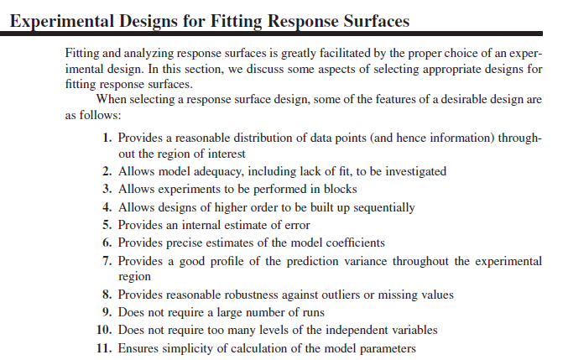
Features for selecting response surface design

Slide 47
Design for fitting the Second-Order Model
There are two main types of response surface designs:
Central Composite designs (CCD)
Central Composite designs can fit a full quadratic model. They are often used when the design plan calls for sequential experimentation because these designs can include information from a correctly planned factorial experiment.
Box-Behnken designs (BBD)
Box-Behnken designs usually have fewer design points than central composite designs, thus, they are less expensive to run with the same number of factors. They can efficiently estimate the first- and second-order coefficients; however, they can't include runs from a factorial experiment. Box-Behnken designs always have 3 levels per factor, unlike central composite designs which can have up to 5. Also unlike central composite designs, Box-Behnken designs never include runs where all factors are at their extreme setting, such as all of the low settings.
Notes:
https://www.youtube.com/watch?v=O0NF4tKe5lM&t=3s

Slide 48
Central Composite designs (CCD)
Central Composite designs (CCD)
A central composite design is the most commonly used response surface designed experiment. Central composite designs are a factorial or fractional factorial design with center points, augmented with a group of axial points (also called star points) that let you estimate curvature. You can use a central composite design to:
Efficiently estimate first- and second-order terms.
Model a response variable with curvature by adding center and axial points to a previously-done factorial design.
Central composite designs are especially useful in sequential experiments because you can often build on previous factorial experiments by adding axial and center points.
Notes:
https://www.youtube.com/watch?v=O0NF4tKe5lM&t=3s

Slide 49
Central Composite designs (CCD)
Central Composite designs (CCD)
For example, you would like to determine the best conditions for injection-molding a plastic part. You first run a factorial experiment and determine the significant factors: temperature (levels set at 190° and 210°) and pressure (levels set at 50MPa and 100MPa). If the factorial design detects curvature, you can use a response surface designed experiment to determine the optimal settings for each factor.
Notes:
https://www.youtube.com/watch?v=O0NF4tKe5lM&t=3s

Slide 50
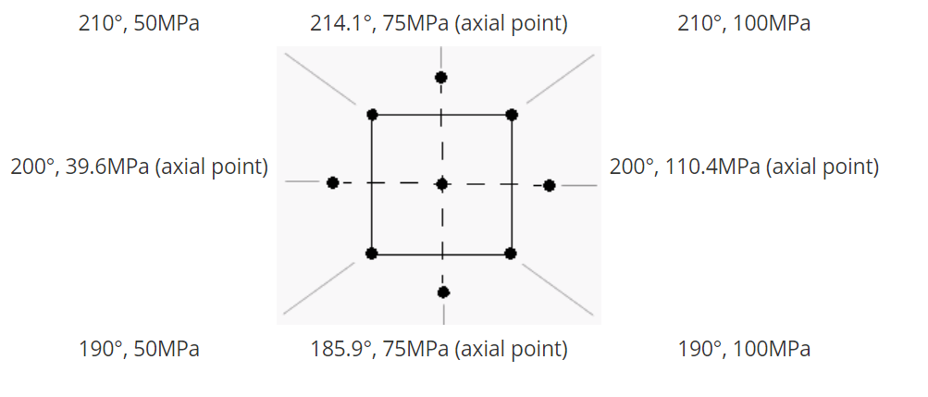
Central Composite designs (CCD)
Central Composite designs (CCD)..continued
Notes:
https://support.minitab.com/en-us/minitab/18/help-and-how-to/modeling-statistics/doe/supporting-topics/response-surface-designs/response-surface-central-composite-and-box-behnken-designs/

Slide 51
Central Composite designs (CCD)
Three parts:
1.
Factorial or reduced factorial design Estimate of main effects and interactions
2.
At least one center point experiment Possible to reveal curvature and estimate the experimental error
3.
Experiments ±α on the variable axes Possible to estimate quadratic terms

Slide 52
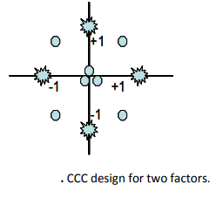
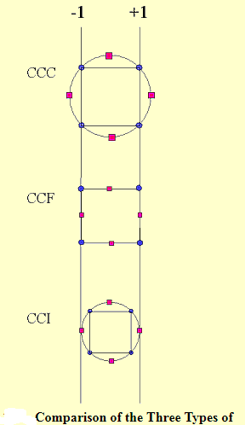
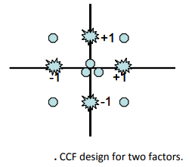
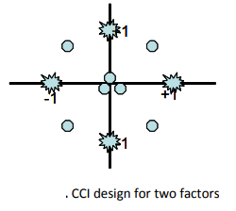
Central Composite designs (CCD)
Central Composite Design (CCD) has three different design points: edge points as in two‐ level designs (±1), star points at ±α; ׀α׀ ׀≤1 that take care of quadratic effects and centre points,
Three variants exist:
Circumscribed (CCC)
Face centered (CCF)
Inscribed (CCI)

Slide 53
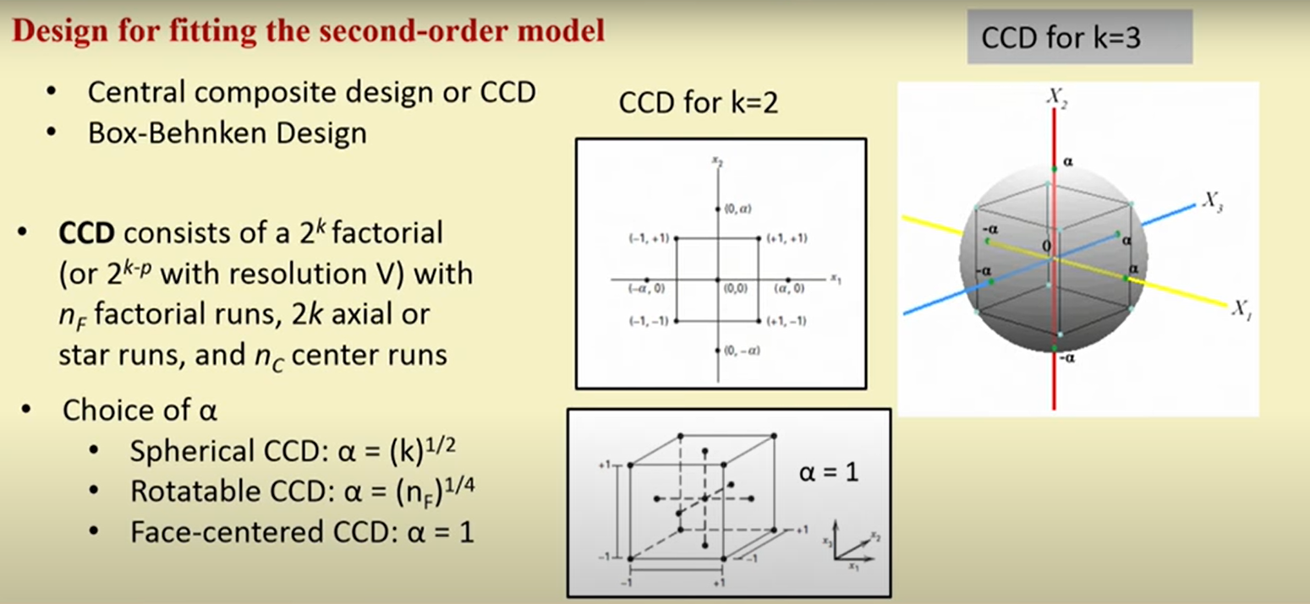
Central Composite designs (CCD)
n_{f} = The number of factorial run

Slide 54
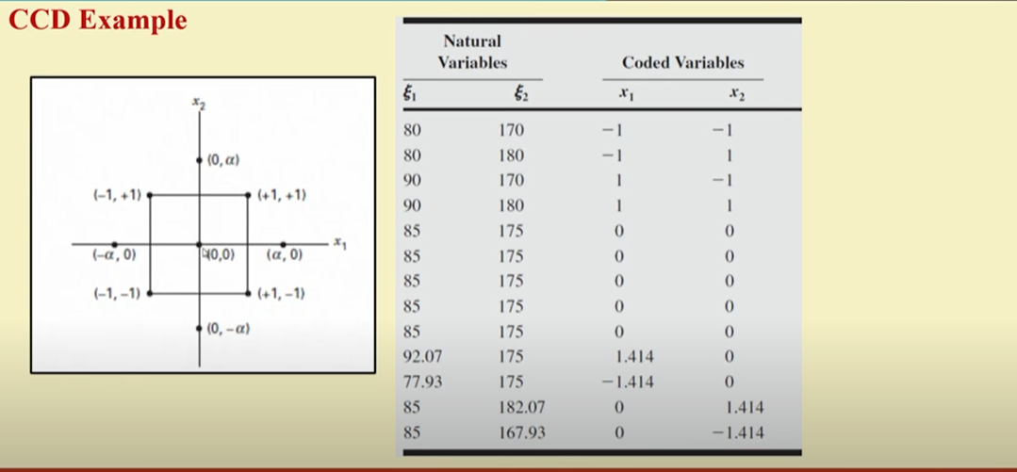
Central Composite designs (CCD)

Slide 55
Central composite rotatable design for two variables
Number of experiments: 2³ + 4 + 6 = 18

Slide 56
Central composite rotatable design for three variables

Slide 57
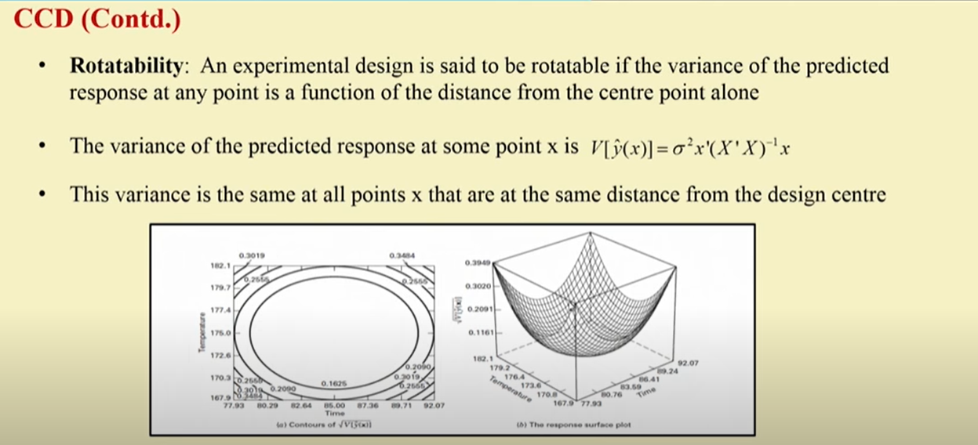
Central Composite designs (CCD)

Slide 58
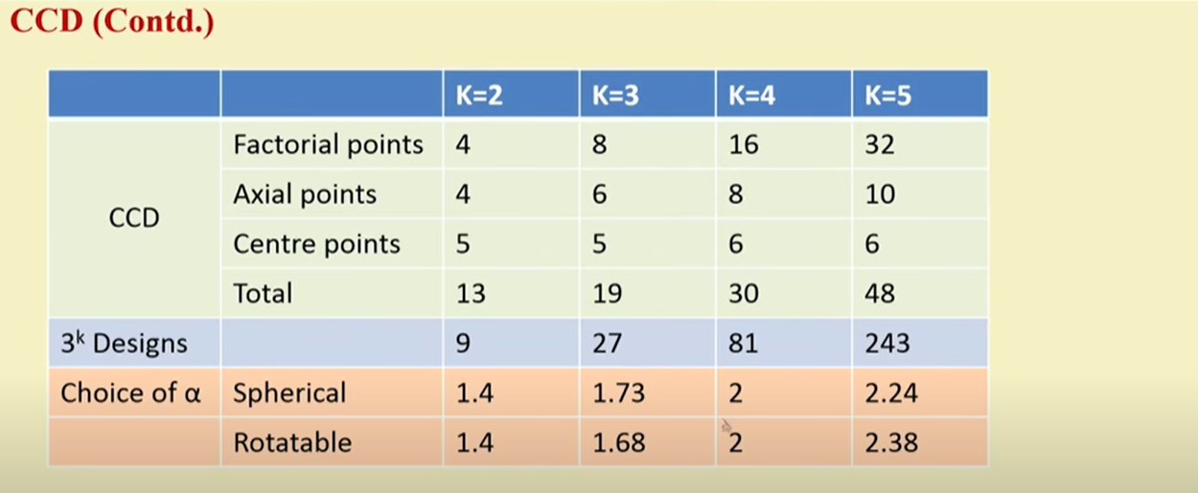
Central Composite designs (CCD)
Number of runs required for CCD and its types, and 3^{k} design

Slide 59

Box-Behnken designs (BBD)
Box-Behnken designs (BBD)
Box-Behnken designs have treatment combinations that are at the midpoints of the edges of the experimental space and require at least three continuous factors. The following figure shows a three-factor Box-Behnken design. Points on the diagram represent the experimental runs that are done:
Notes:
https://support.minitab.com/en-us/minitab/18/help-and-how-to/modeling-statistics/doe/supporting-topics/response-surface-designs/response-surface-central-composite-and-box-behnken-designs/

Slide 60
Box-Behnken designs (BBD)
Box-Behnken designs (BBD)
A Box-Behnken design is a type of response surface design that does not contain an embedded factorial or fractional factorial design.
For example, you would like to determine the best conditions for injection-molding a plastic part. The factors you can set are:
Temperature: 190° and 210°
Pressure: 50Mpa and 100Mpa
Injection speed: 10 mm/s and 50 mm/s
For a Box-Behnken design, the design points fall at combinations of the high and low factor levels and their midpoints:
Temperature: 190°, 200°, and 210°
Pressure: 50Mpa, 75Mpa, and 100Mpa
Injection speed: 10 mm/s, 30 mm/s, and 50 mm/s
Notes:
https://support.minitab.com/en-us/minitab/18/help-and-how-to/modeling-statistics/doe/supporting-topics/response-surface-designs/response-surface-central-composite-and-box-behnken-designs/

Slide 61

Box-Behnken designs (BBD)

Slide 62

Box-Behnken designs (BBD)

Slide 63

Box-Behnken designs (BBD)

Slide 64

Box-Behnken designs (BBD)

Slide 65
Thank you

